Slide 1
Backend Spring Boot

Slide 2
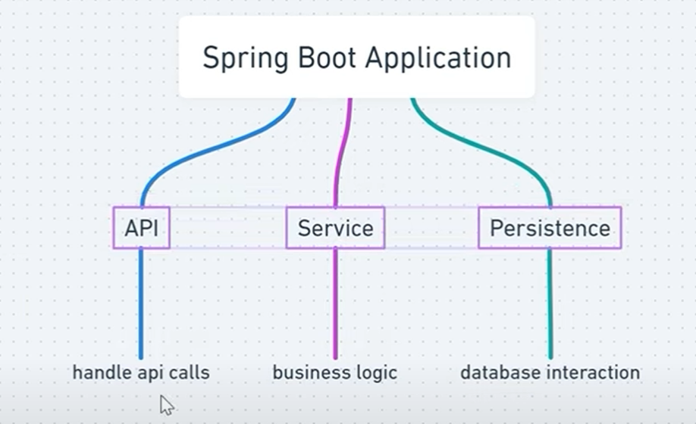
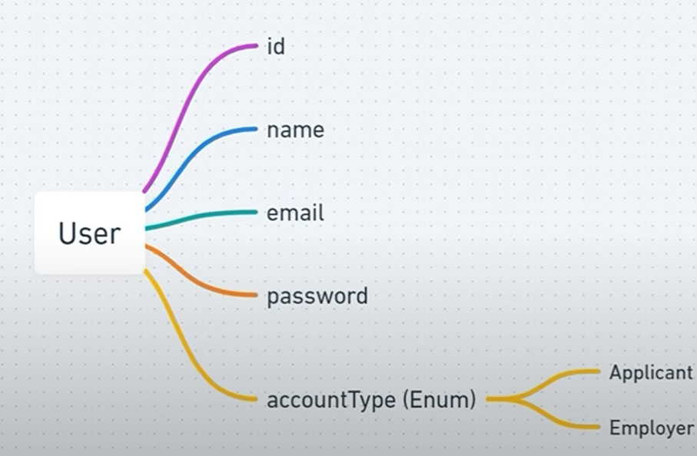
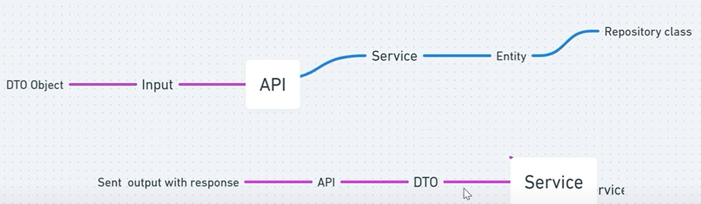
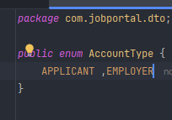
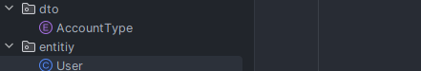
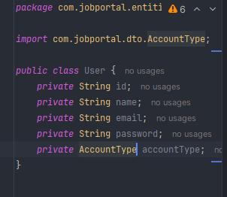
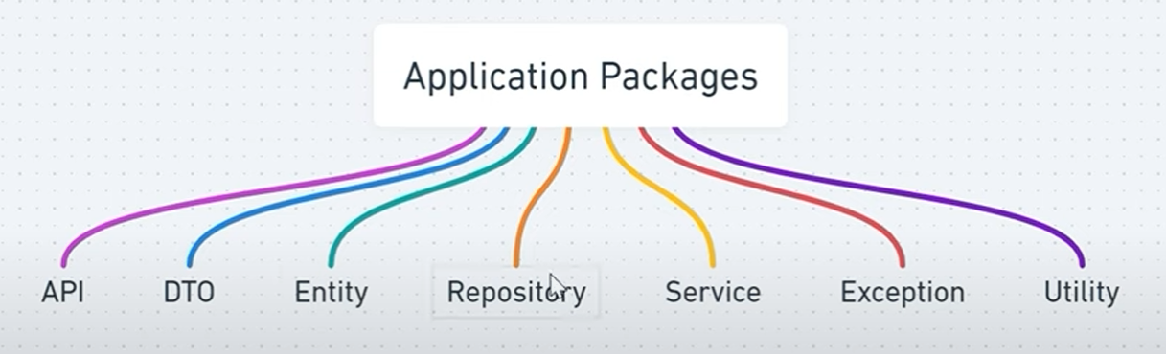
Work flow
User table
Pacakage Needed
Dto – data transfer obj use to ransfer data btw java and entity for database operations
Handel api req like controller :create data POST req to add job in db
To Take Data from entity and convert it to java
And vise verse
Create tb object
Handel Data Base Operation like JPA
Actual working code with logic and execute command on Repo
Validaion

Slide 3
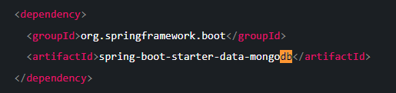
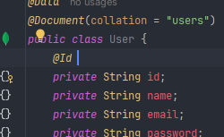
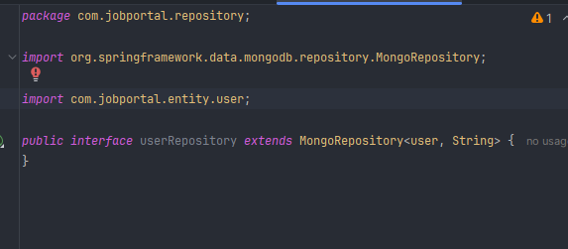
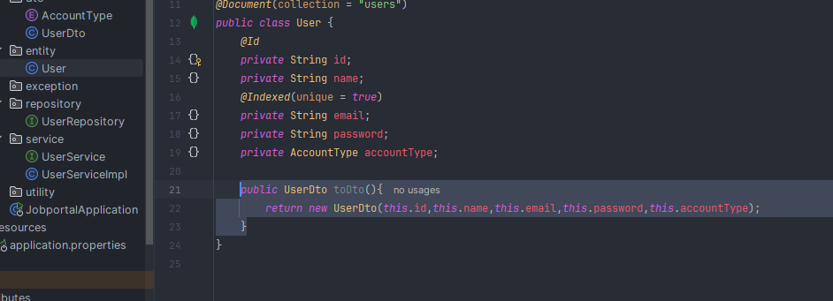
dependencies
Allow non duplicate value to enter
Create user repository with all crud methods
Passing data btw entity to dTO

Slide 4
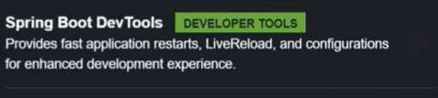
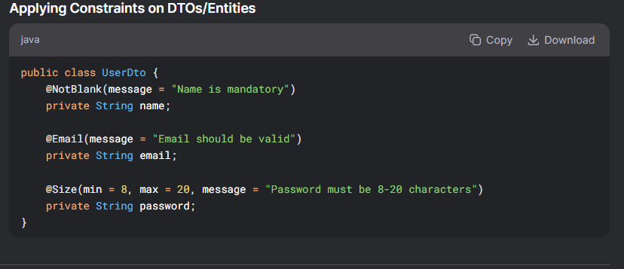
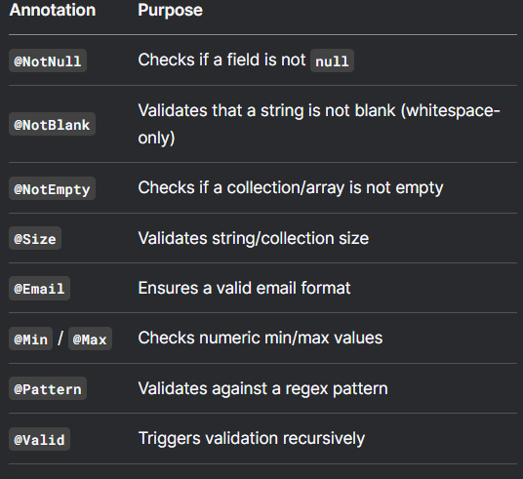
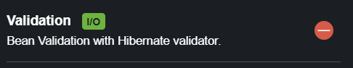
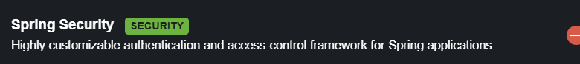
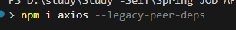
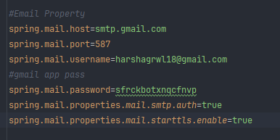
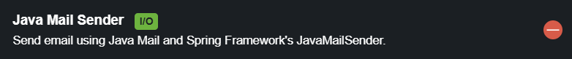
dependecies
Live reloade u not need to do save and rerun everytime
Ti validate data reduce code for various things
For Passowrd EncryPtion
Toget data from backend
Otp

Slide 5
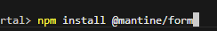
dependecies
React - redux
Maintine Forms

Slide 6
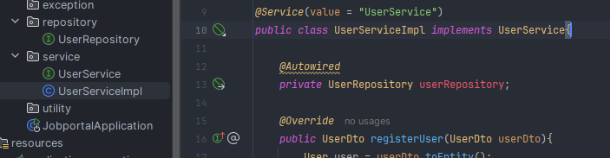
connect service to interface
If you have an interface of service and seprate classes to connect all these classes to Interface we use target

Slide 7
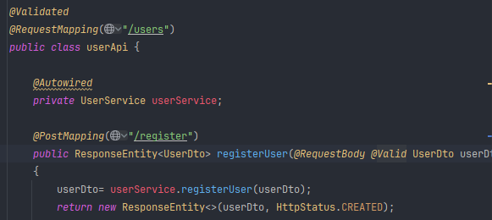
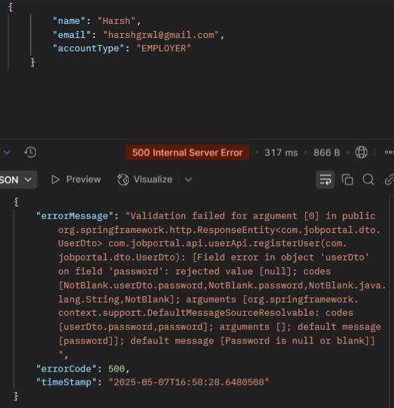
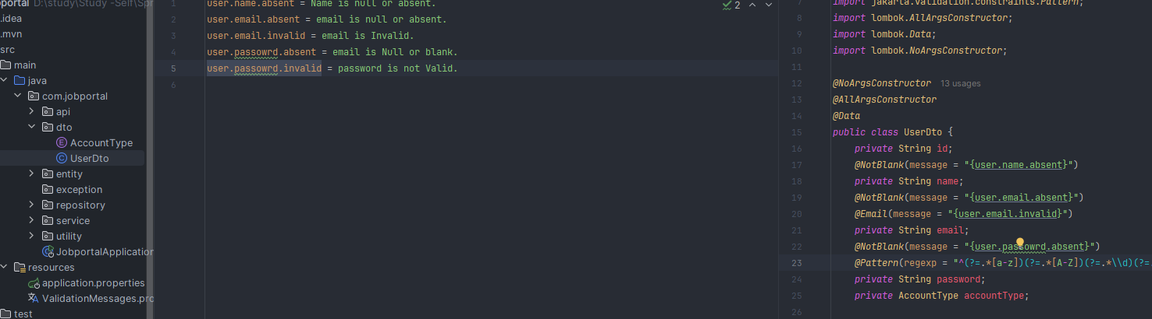
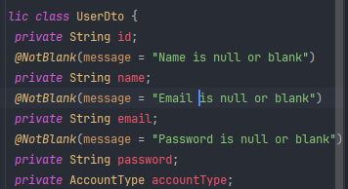
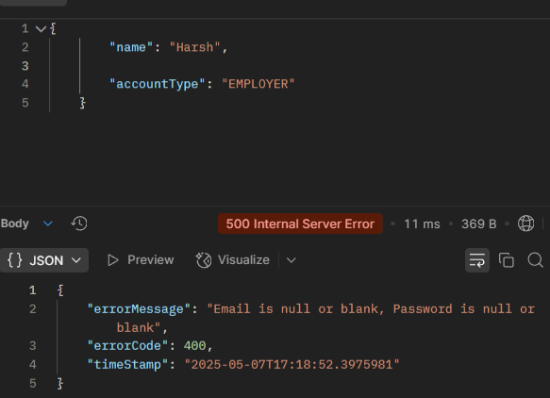
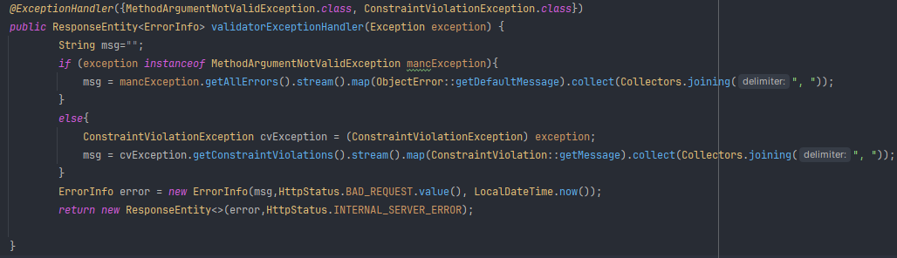
To show only default msg and Prevent non valid data to enter in db
ValidAtion / Valid email name :
How to Connect
Passing msg as variable from file
Connect with api
Make its easy to cange msg from multiple location
Handel 2 Exp :
if arg is not valid
Is violationRules/constraint
Obj of
If expection is instance od methodargnotValid
If 1st error ->get all errors-
>make copy of data in stream
->map idefault msg fun from obj error class-
> Collect use to collect the msg and the join after one another
Call fun getDef fun of Obj Class
Join diff msg
Main Logic 1. Check for Multiple Exception
2.If Found any Pass the Exception Default msg into msg variable 3. pass it to error info obj and print

Slide 8
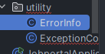
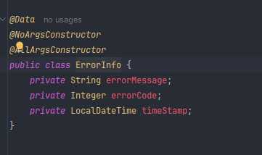
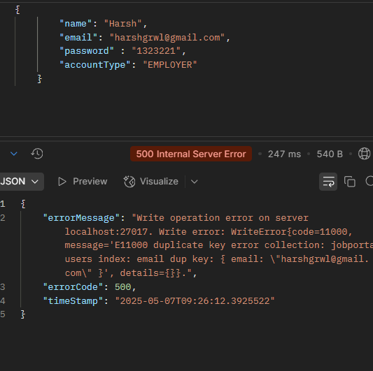
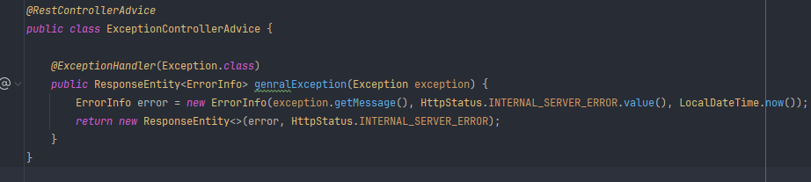
Utility Validation
Obj with data u want to show when exception occur
Exception is Duplicate Data
Advice Wht happen when Exception occured
ErrorInfo Constructor -> (msg,error code,time)

Slide 9
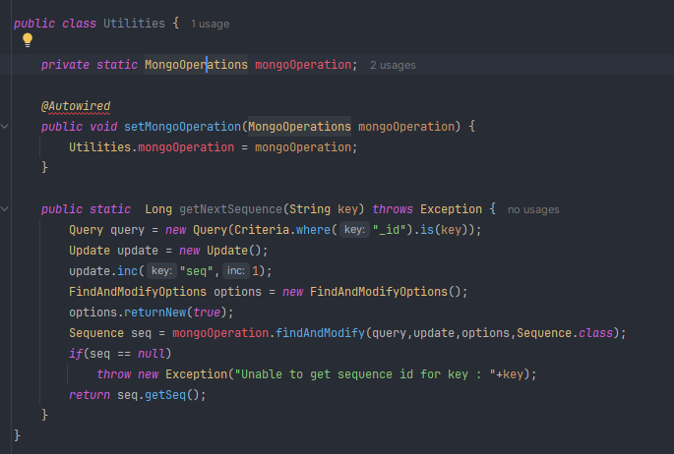
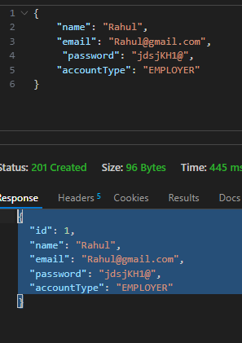
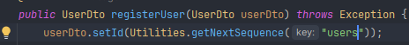
Passing custome Query to incerement
Made Function and Mongo Satic so we don’t need to make an obj to call
Create mongOperation to Perform Query
Cant Direct AutoWire an Static Object
Grab Data with query Perform Update by 1 Options // not medatory use as it start with 0
Adding in seq obje (q,u,o,belong to which class)

Slide 10
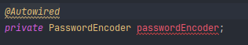
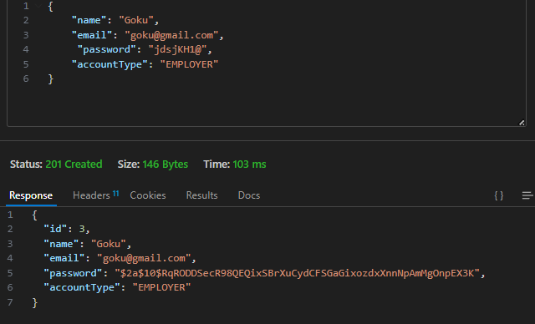
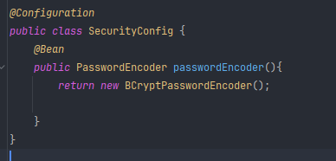
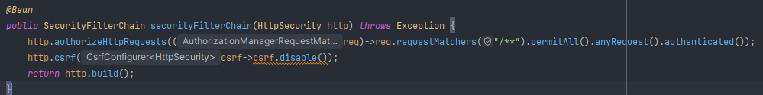
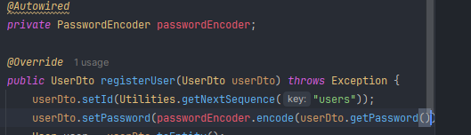
Decrypting Password
Can not Create a Driect Bean Need A
Constructor Injection
Configure to Define it’s a Configuring File
It’s a Bean
PerMit all Req
Return Bean

Slide 11
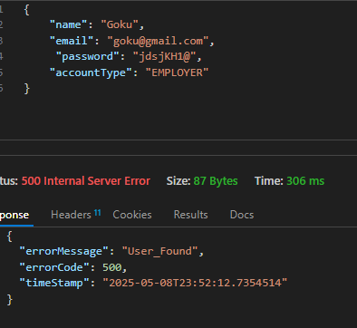
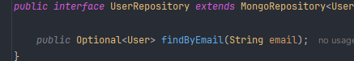
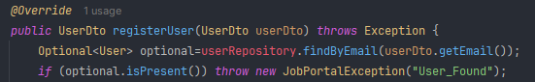
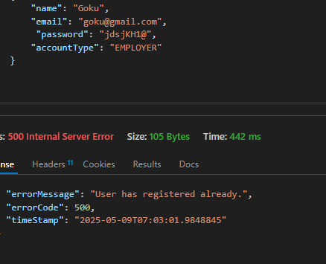
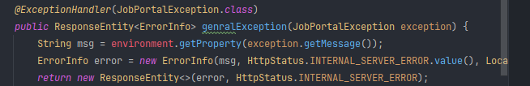
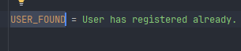
Remove long email Duplicate error with small msg
Imporve iTs Query By Enviroment Variable
If has same email then through Jobportal Exception with enivorment variable.get property & execption .get msg toget passed msg

Slide 12
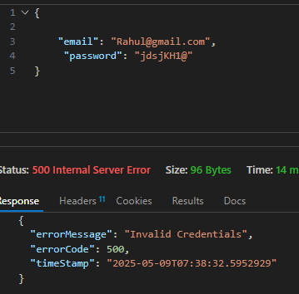
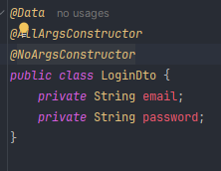
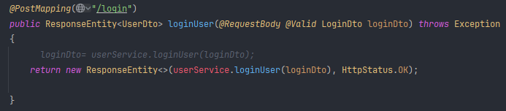
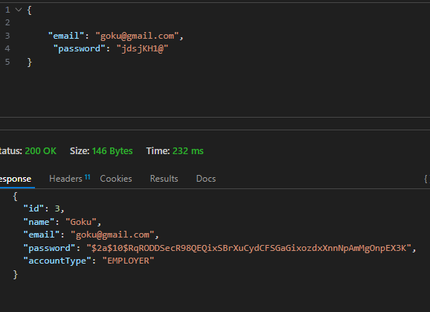
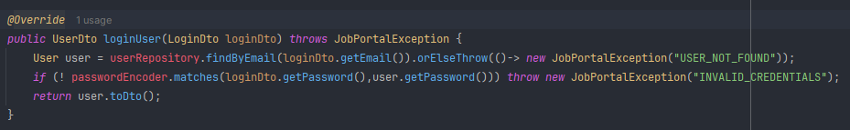
Valid Login Credential
Crete login DTO
Create Login Api Route
3. in Service
If email is avialbel through
Match password with encrypted pass
Correct pass

Slide 13




Connect Backend And PRonend
Connect a base urlx
1.Send post req
2. If pos is successful Get in res (then used as if)
3. To handel error if occur (exception handeling of spring)
Account type is a radio button which return string cause error to handel that if default value from applicant changes change it to employees
1
Name is passed for json output
3
Create a Blank form Variable to
Set Defualt Data
Take Data
Pass that json like data to fun
2
Set data As Json Formate

Slide 14







Signup form Validation
1
Functoin that take name: value return data acc to Swtich Cond
FormError is a Copy of Form
setFormError (add everything in formError , sig(name,val)
Ist check password to confirm pass , sec if check in rev
2
3
4
Same execution
(Name ,val) -> password ,123
Sign(password,123) -> output – 8-15char
formError
“password” : “9-15char”

Slide 15


Only send Data when Everything is right
Notification system and
Redirect after 4 sec
Clear Form
Skip if name == account type
If ANY string in error consider as error : v-false
If password do not match don’t : v-fale
If valid is true then only submit the data

Slide 16
Password Reset
3 Step Process
Email is send acc to email
sendOtp(email)
Verifing The Otp
verifyOtp(email,otp)
Change Password
ChangePass(Old login Details)
Clearing otp
Remove expired otp()

Slide 17











Send Otp
Output
Otp html page
Where msg needed to send
Logic
Email is Check if avilabel in db
Create MemeSender,MimeMessage,Helper(help to send in parts)
Set to Where msg need to send
Genrate otp
Add in DataBase
Add Data in message(HtmlPage,Html=true)

Slide 18



Otp Validate
Path Variable Validation -> email,otp pattern
Logic
Email is Check if avilabel in db
If Otp Matches With Db Otp

Slide 19




Password Change
Logic
Email is Check if avilabel in db
For USER ->Change new Password with old
Save change n DB
Delet ot After every 5min
Logic
Command Run Auomatically after every 60s
If exiry is > 5 min then remove otp data from db

Slide 20







Front End Implementation
Otpsend Fun
1.otpSend ✅ : Make pin only visible when true
2. otpSend ✅ && verified ❌ : resend and change
3. Verified ✅ : Password Input and Change pass
For loading animation in Button
Button loading ={otpSending}

Slide 21


Redux
Reducer r Trigger by action to perform state update on store
It hold the data
Action are function what is going to perform
Action has 2 parameters
Process Flow
2 Libraries to use

Slide 22





Local Storage
-Local Storage is a Permanet Storage in Brower Attached to a Paritcular ip/web address
it kept value even after refresh
Localstorage.setItem / getItem it is a JavaScript Function
Creating a slice: UserSlice
Slice is aCombination of Reducer and Action
Slice name
3 Values
Slice : {name,initiastate,reducer}
Initial Value in slice
Reduce has state and Action
State: value/
Action : 2 var (type,payload)
Import User Slice
As Fun in store
2 function 1. setUser : set value in local storage and update state to nre data
2. Remove Data from local storage and upate state to null
Export:
Normal fun
Default export is reducer from userSlice

Slide 23





Dispatch Action with Reducer
Slice Name user Data By SetUser Function in Reducer
Dispatch Action with reducer
Login Data Save in Slice
Logout

Slide 24





To get Data From Loacal-Storage Redux
Take Data From slice name = user
Get initial State first , if Updated then Updated State
Show login / name if logged in
Remove Signup if
Logged in
Move BrowserRouter from app.tsx to seprate file as to apply Redux we need it in provider

Slide 25
---------- Data Fething Start --------

Slide 26











Profile page
Create
Profile: Entity/Dto- >Exp:Dto ->Certif:dto
Repo
Service
No Api Calling : as Called internally when user login through Function
Add
For Creation of Data it is Created by Registed user
Service
API
Get data in profile

Slide 27


API
Update Data in Profile

Slide 28








How data is passed between React+Redux+mantine Form
Fornt end
Back end
useEffect
Needed when u want to load the do seomrthing when page loaded without calling a fun , here need to set data into state using dispatch setPrifile
To call reducer function
To Get Data Acc to State
SetInitial
SetInitial value in form using useform()
Intitial value as Obj Validate : if req to set validation
Set data in redux store
Pass value in form

Slide 29




Fronend implementaion
Why used effect is used ?
1. It execute When profile Page Loaded no need to execute by onclick like a function 2. as it execute when page loaded so profile data is sahred among all the pages that under this profile section
Sluce
Use it like props
1.Set data into profile slice then
2. Get that data into profile variable using selector

Slide 30







sa
Create form with 3 var
onClick ✏️ set value in form from profile slice
onClick 💾 change profile value to form value and dispatch udateFunction
SelectInput.tsx
Pass form data as props into selectinput
Take data of propsform acc to props name
Field are hardcoded data

Slide 31

Easy understading Same thing happen for about

Slide 32







To edit profile Image
Add Data in Backend
Pic store as
1.byte in db
2. String in java
If there is pic
Encode byte -> convert to string
Pass to
If there is pic
DeEncode byte -> convert to string

Slide 33



Job Added by Comp backend
Calling these Function from Fronend
3 Function
Post Job
Get all Jobs
GetJob by id

Slide 34






Post Job /1st fun
Find Job Page
Pass this data into form
Laod data into Select Input
Form is Created with
Job inputs for database
1.Api call the service
To post job if form is valid
2. Show notification
3.redirect to posted jobs

Slide 35







Front end -> find Jobs
. 2. Get all hjob
3. Findjob acc to id
All Posted Jobs Come Here
On Click on Card Redirect To Job DESC page Acc to job id
Find Job Page
4
params
1
Change Props Name acc to data
3
2
Get details of all jobs in job list an pass it into Job Card
Use Props As required
5

